Slide 1
NT219- Cryptography
Week 12: Cryptography Applications (P1)
PhD. Ngoc-Tu Nguyen
tunn@uit.edu.vn

Slide 2
Outline
Network secure protocols
Authentication;
Key agreement;
Cryptographic negotiation;
SSL/TLS; SSH; IPSec; Kerberos;
Blockchain-base network
Lattice-bases cryptography and Post-quantum security
Notes:
Cipher=a secret system of writing;

Slide 3

Textbooks and References
Text books
[1] Chapter 14.15

Slide 4
Security goals
Goals
Cipher systems
- Symmetric (DES, AES)
- Asymmetric (RSA, ECC, CRYSTALS-KYBER)
Confidentiality
Privacy
Integrity
Hash functions
Message authentication code (MAC)
Digital signature (digital certificate)
Authentication
Non-repudiation (Accountability)
Access control
RBAC, ABAC, PBAC
Availability

Slide 5










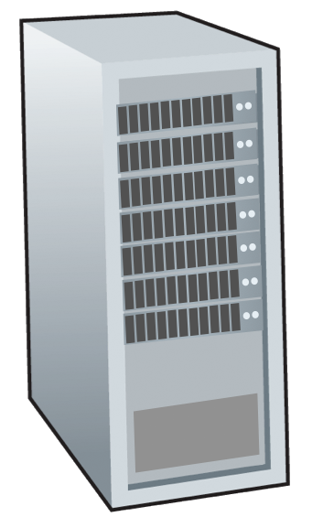




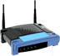





Motivations
Network devices:
End devices
Intermediate devices
mobile network
national or global ISP
Communication links
fiber, copper, radio
transmission rate: bandwidth
local or regional ISP
Internet
home network
content
provider
network
Network protocols
How to secure storage and exchange data?
datacenter
network
enterprise
network
Send?
Receiver?
Storage?

Slide 6
Network secure protocols (P1)
Authentication
Public key (Certificate) approach
Prior secret-shared approach
Cryptographic algorithm negotiation
Ciphers, MAC, Digital Signature
Key agreement
Diffie-Hellman key exchange + extra…
Key encapsulation mechanism
Secure protocol implementation
Chosen layer to implement
Chosen cipher to encrypt exchange data
Notes:
Cipher=a secret system of writing;

Slide 7


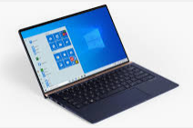

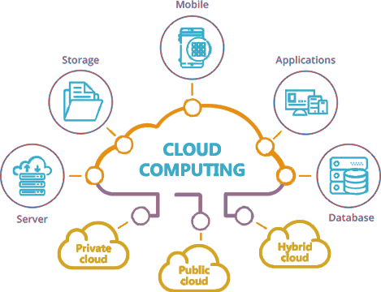

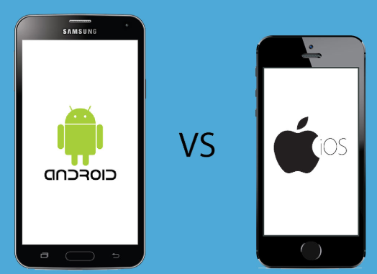


Motivations
Secure protocool goals:
Mutual authentication
System parameters and cryptographic algorithms?
Key agreement
(3)
User
User
Iot/Edge/fog/cloud network
(1)
Local system
(4)
(A) /
Remote
server
(5)
AI/ML
User
(2)
Notes:
authentication factors= Các yếu

Slide 8
Authentication and Authorization
Authentication (users, hosts, process or programs)?
Authentication= “ Verifying the identity of a user, process, or device, often as a prerequisite to allowing access to resources in an information system”
Authentication process=
Identification information
Verification
 https://csrc.nist.gov/glossary/term/authenticationation
Authorization
The right or a permission that is granted to a system entity to access a system resource.
 https://csrc.nist.gov/glossary/term/authorization
Notes:
The process of verifying = Quá trình xác minh
Authentication= xác thực

Slide 9
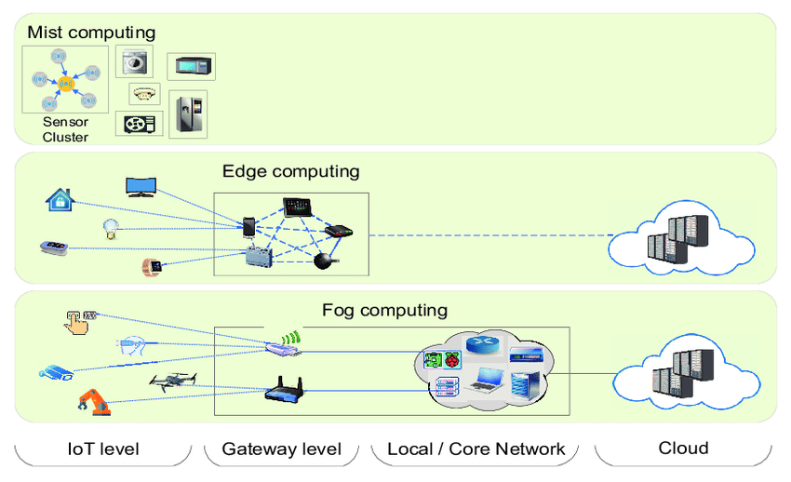
Authentication
Users authenticate server/host/ resources
?
?
?
?
?
?
Notes:
authentication factors= Các yếu

Slide 10
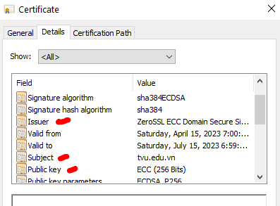
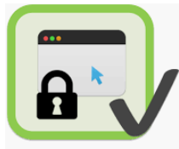
Authentication
Users authenticate server/ nodes/ resources: digital certificate/pre-share secrets
Remote
server
?
?
openssl s_client -connect www.facebook.com:443
Notes:
authentication factors= Các yếu

Slide 11
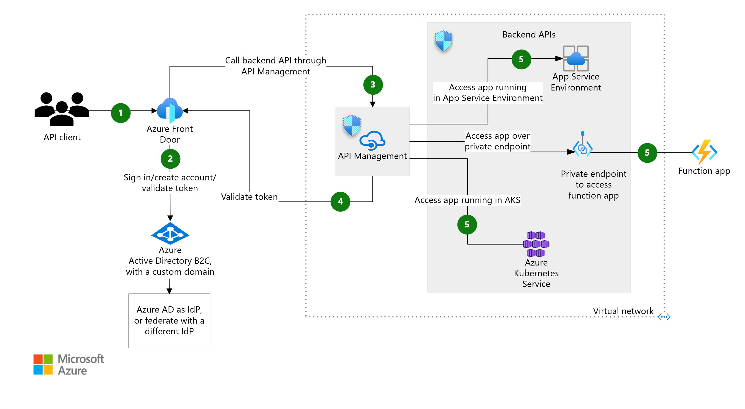
Authentication and Authorization
Notes:
authentication factors= Các yếu

Slide 12
Authentication
Authentication factors
Knowledge (something the user/node knows)
ID, Password, PIN, answers to prearranged questions
Possession (something the user/node has)
Smartcard, electronic keycard, physical key, user’s devices, digital certificates, …
Inherence (some physical characteristic of the user/devices)
Fingerprint, retina, face, voice pattern, handwriting, typing rhythm, PUFs,…
Notes:
authentication factors= Các yếu

Slide 13
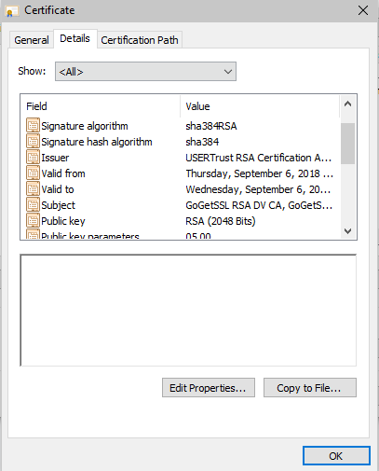
Authenticate server/resources
Certificates-based authentication
Remote server
Certificate
Public key/ Secret key
Exchange authentication/
key agreement data
Combine:
Public key
Server Identity (IP, name,…)
Trusted CA
PKI

Slide 14
Certificate implementation
CA
CA
CA
CA
Directory
Services
CA
RA
CA
CA
CA
RA
RA
Internet
RA
RA
RA
Required
Server certificate
Root CA certificate (CA Public key)
Internet
LRA
LRA
openssl s_client -connect facebook.com:443 -showcerts

Slide 15
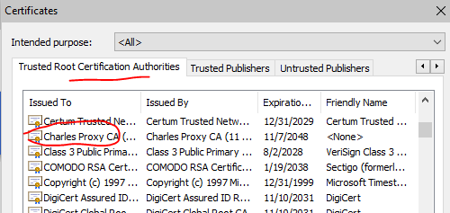
Authenticate server/resources
Limitation
Certificates-based authentication
Need PKI
Revocation?
Network Payload?
Trusted CA?
Semi-Trusted
Zero-Trusted

Slide 16
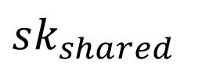
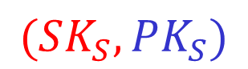

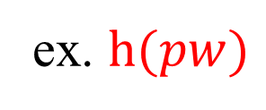
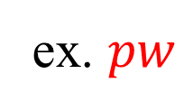
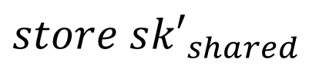
Authenticate user/end-devices
Remote server
?
Server Certificate
$$(SK_{S}, PK_{S})$$
$$verify (certificate, PK_{root})⇒PK_{S}$$
How the server authenticate the user?
Using pre-shared secrets
$sk_{shared}$
$store s{k′}_{shared}$
ex. $pw$
ex. $h(pw)$
Notes:
authentication factors= Các yếu

Slide 17
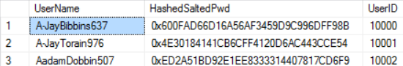
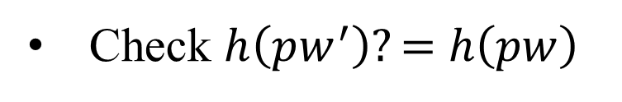
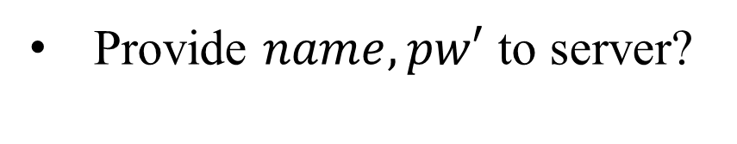
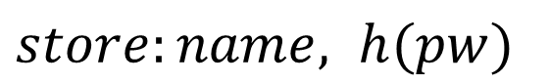
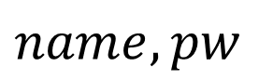
Authenticate user/end-devices
(1) Password-based Authentication
$store:name, h(pw)$
$name, pw$
Login
Provide $name, pw′$ to server?
Locate the row using name
Check $h\left(pw^{′}\right)?=$ $h\left(pw\right)$
authenticate the user
Notes:
authentication factors= Các yếu

Slide 18
Authenticate user/end-devices
Password-based Vulnerabilities
Pre-shared secrets
Human-memorable password
Small space of possible passwords
(1) Dictionary attacks
(2) Verification table attacks
• • •
Offline Dictionary attacks
https://hashkiller.io/listmanager

Slide 19
Authenticate user/end-devices
(2) Multiple factor Authentication
Pre-shared secrets
Passwords
Biometric (variation)
Verification?
Secure storage?
Password
Biometric (user/device)
Smartcard
Hardware-assisted
Smartcard
Secure storage
Do some verification
algorithms
Hardware-assisted (TPM, TEE, secure enclave...)
Secure storage
Do some secure algorithms
One-to-One?
One-to-many?
Scale-up ability?

Slide 20
Network secure protocols
Authentication
Public key (Certificate) approach
Prior secret-shared approach
Agreement on cryptographic algorithms
Key agreement
Diffie-hellman key exchange + an other factor
Deployment
Chosent layer to implement
Chosen cipher to encrypt exchange data
Some example secure protocols
Notes:
Cipher=a secret system of writing;

Slide 21
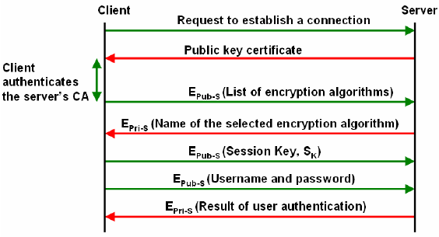
Network secure protocols
Example: SSH protocols
Why?
Notes:
Cipher=a secret system of writing;

Slide 22
Network secure protocols
Authentication
Public key (Certificate) approach
Prior secret-shared approach
Key agreement
Diffie-hellman key exchange + an other factor
Agreements of cryptographic algorithm
Deployment
Chosent layer to implement
Chosen cipher to encrypt exchange data
Some example secure protocols
Notes:
Cipher=a secret system of writing;

Slide 23




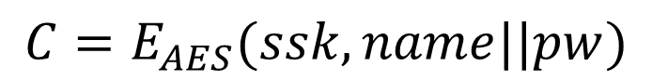
Session Key agreement mechanism
Remote server
?
Server Certificate
$$SK_{S}$$
$$verify (certificate, PK_{root})⇒PK_{S}$$
How to send $(name,$ $k_{shared}$) to server?
$$C=E_{AES}(ssk, name||pw)$$
$$D_{AES}\left(ssk,C\right)=name||pw$$
Notes:
authentication factors= Các yếu

Slide 24
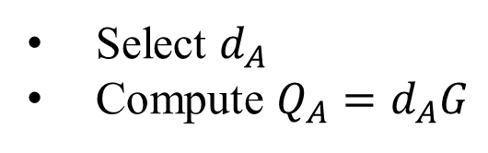
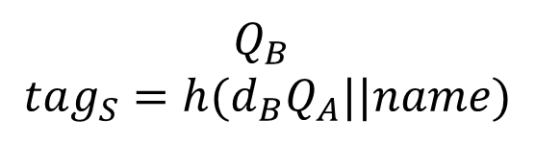
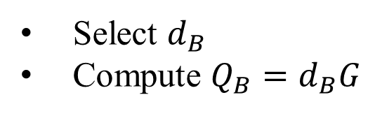
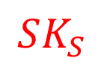
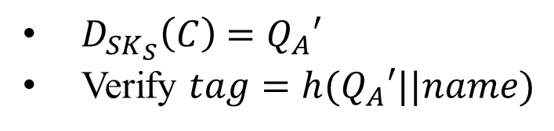

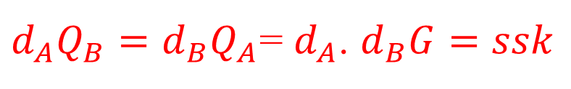
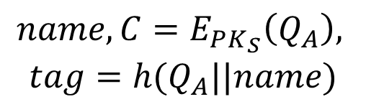
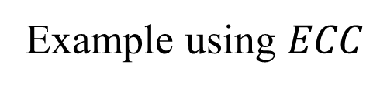
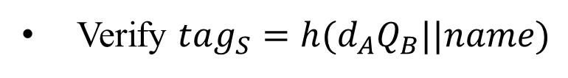
Session Key agreement mechanism
Remote server
?
Server Certificate
$$SK_{S}$$
$$verify (certificate, PK_{root})⇒PK_{S}$$
Using Diffie-Hellman key exchange + server public key
Example using $ECC$
Select $d_{A}$
Compute $Q_{A}=d_{A}G$
$${name, C=E}_{PK_{S}}\left(Q_{A}\right),$$
$$tag=h(Q_{A}||name)$$
$D_{SK_{S}}\left(C\right)$ $=Q_{A}′$
Verify $tag=h(Q_{A}′||name)$
$$Q_{B}$$
$$tag_{S}=h({d_{B}Q}_{A}||name)$$
Select $d_{B}$
Compute $Q_{B}=d_{B}G$
Verify $tag_{S}=h(d_{A}Q_{B}||name)$
$d_{A}Q_{B}={d_{B}Q}_{A}$= $d_{A}$. $d_{B}G=ssk$
Notes:
authentication factors= Các yếu

Slide 25

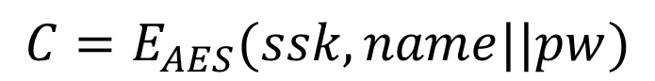
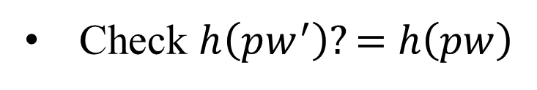
Session Key agreement mechanism
Remote server
?
Server Certificate
$$SK_{S}$$
$$C=E_{AES}(ssk, name||pw)$$
$$D_{AES}\left(ssk,C\right)=name||pw$$
Locate the row using name
Check $h\left(pw^{′}\right)?=$ $h\left(pw\right)$
authenticate the user
Notes:
authentication factors= Các yếu

Slide 26
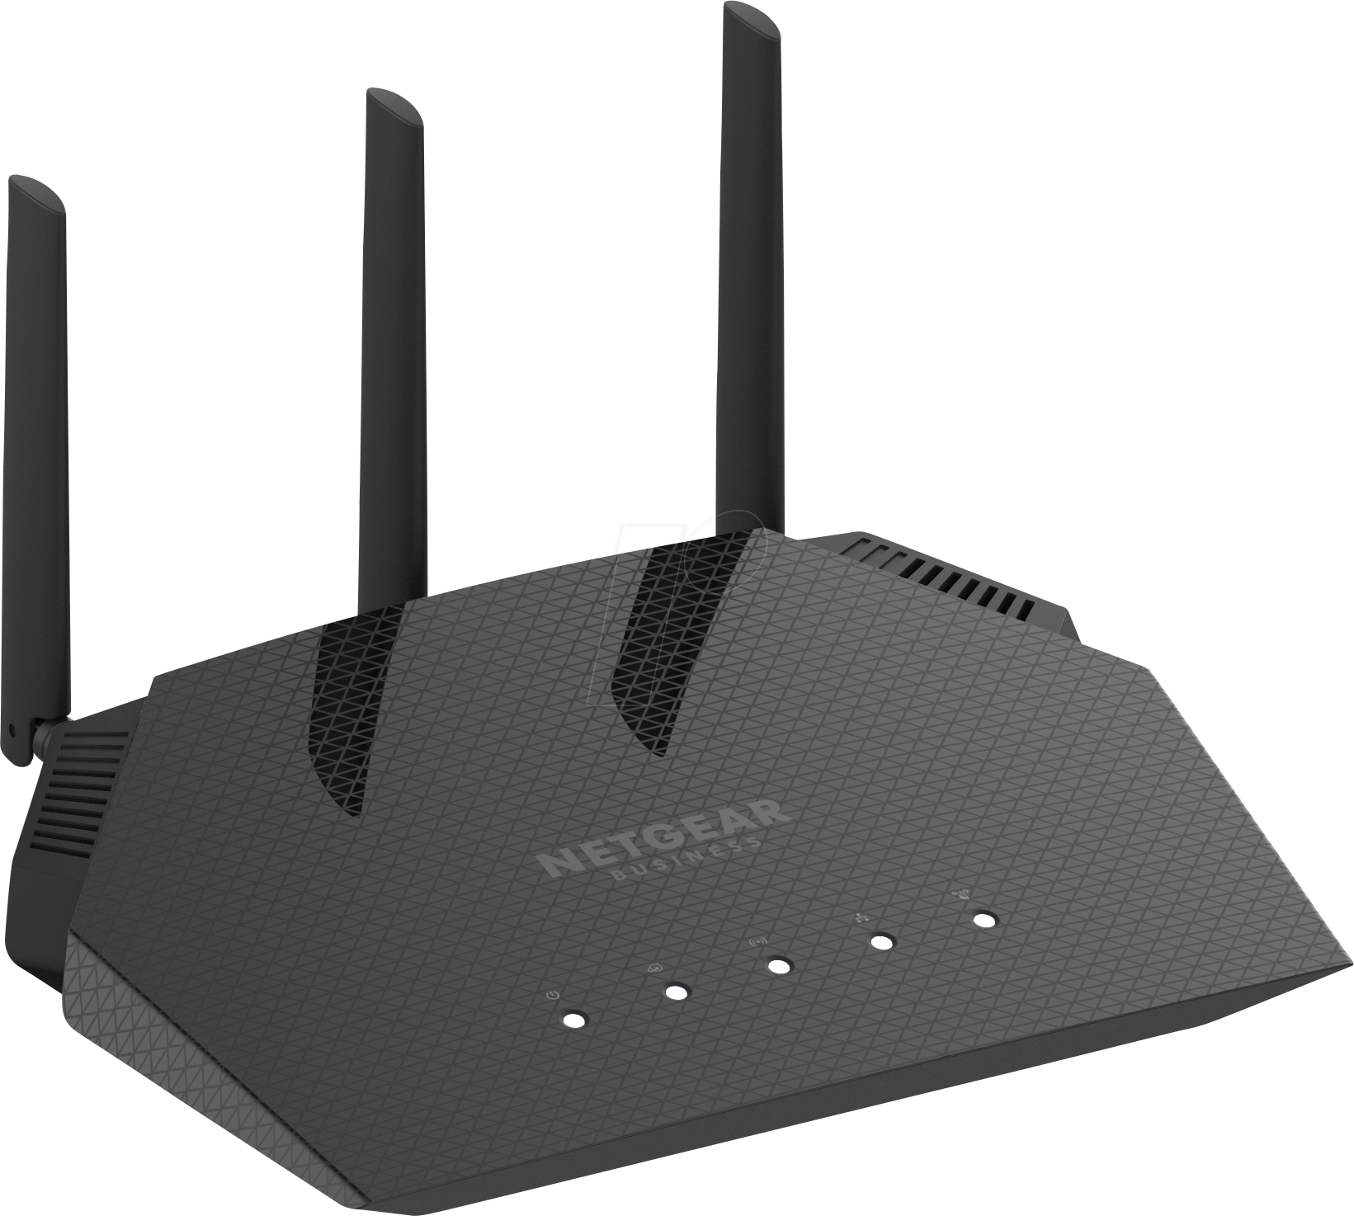
Session Key agreement mechanism
Remote server
?
Server Certificate
$$SK_{S}$$
$$verify (certificate, PK_{root})⇒PK_{S}$$
How authenticate each other if the server does not have certificate?
wifi access point
User
Using pre-shared secret
Password
Password
WEB, WPA2, WPA3 protocols
Notes:
authentication factors= Các yếu

Slide 27


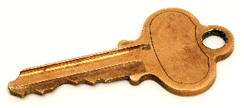

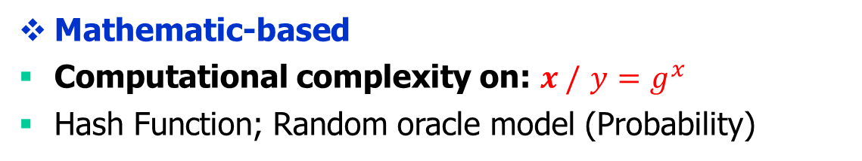
Multi-server environments
Certificateless AKA 1
Secure communication protocols
Authentication +
Goals:
One time registration
Security features: Mutual authentication,
Key agreement, Untraceability, Revocation, Efficiency
Mathematic-based
Computational complexity on: $x /$ $y=g^{x}$
Hash Function; Random oracle model (Probability)
Authentication factors: Passwords, smart card, biometric.
Chang, Chin-Chen, and Nguyen, Ngoc-Tu. "An Untraceable Biometric-Based Multi-server Authenticated Key Agreement Protocol with Revocation." Wireless Personal Communications 90.4 (2016): 1695-1715.

Slide 28
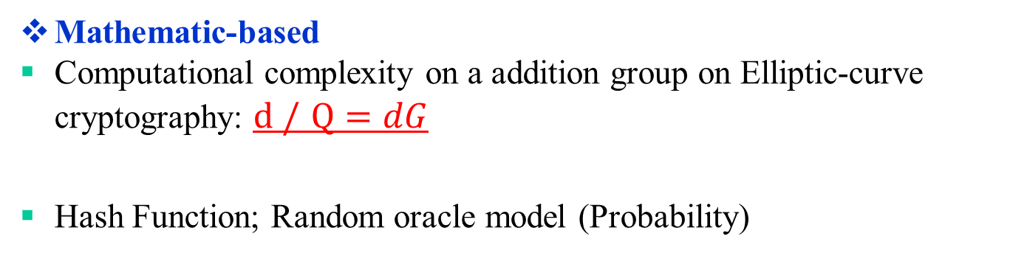
Three-party AKA Protocol
Certificateless AKA 2
Trusted
Server
Authentication+
Secure communication protocols
Goals:
Security features: Mutual authentication, Key agreement, Untraceability Revocation, Efficiency
Provable security in ROR model
Mathematic-based
Computational complexity on a addition group on Elliptic-curve cryptography: $d /$ $Q=dG$
Hash Function; Random oracle model (Probability)
Authentication factors: Passwords, smart card, biometric.
Nguyen, Ngoc-Tu, and Chin-Chen Chang. "Untraceable biometric-based three-party authenticated key exchange for dynamic systems." Peer-to-Peer Networking and Applications 11.3 (2018): 644-663..

Slide 29
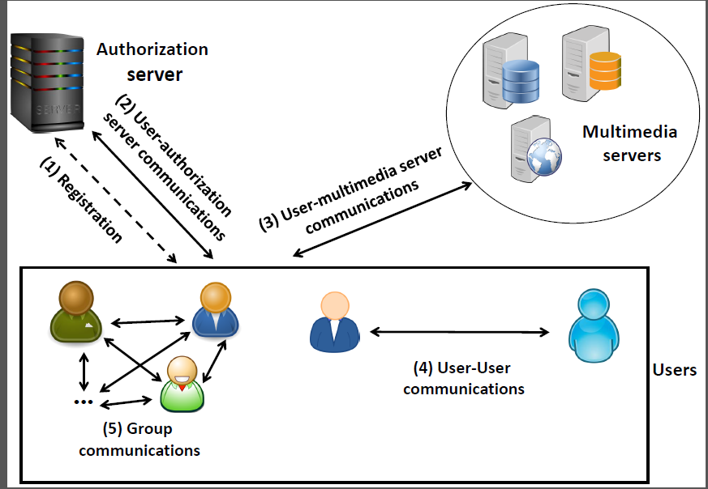

SIP Protocols
Certificateless AKA 3
Mathematic-based
Computational complexity on a addition group on Elliptic-curve cryptography:
$d /$ $Q=dG$
Nguyen, Ngoc-Tu, and Chin-Chen Chang. "A biometric-based authenticated key agreement scheme for session initiation protocol in ip-based multimedia networks." Multimedia Tools and Applications (2018): 1-39.

Slide 30
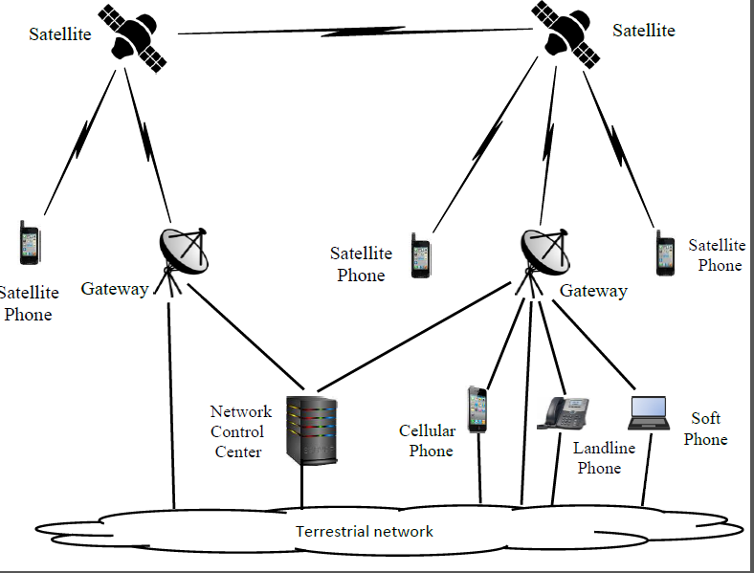

Satellite Mobile Protocols
Certificateless AKA 4
Mathematic-based
Computational complexity on a addition group on Elliptic-curve cryptography:
$d /$ $Q=dG$
Nguyen, Ngoc-Tu, and Chang, Chin-Chen. "A Biometric-based Authenticated Key Agreement Protocol for User-to-user Communications in Satellite Mobile Networks.“, Wireless Personal Communications. 2019 Aug 1;107(4):1727-58

Slide 31
Network secure protocols
Authentication
Public key (Certificate) approach
Prior secret-shared approach
Agreements of cryptographic algorithm
Key agreement
Diffie-hellman key exchange + an other factor
Deployment
Chosent layers to implement
Chosen cipher to encrypt exchange data
Some example secure protocols
Notes:
Cipher=a secret system of writing;

Slide 32
Deployment network secure protocols
Encryption and authentication algorithms are building blocks of secure network protocols
Deploying cryptographic algorithms at different layers have different security effects
Where should we put the security protocol in the network architecture?

Slide 33
Deployment network secure protocols
How to establish secure protocol?
Authentication?
Key agreement
Chosen cipher for exchage data
AES-128-CBC, SHA256,
AES-256-GCM, SHA3-512, …
Notes:
Cipher=a secret system of writing;

Slide 34
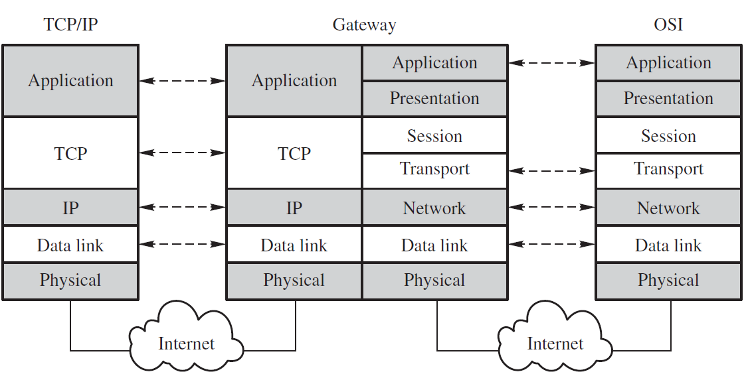
Where should we deploy the secure protocol?
Deployment network secure protocols

Slide 35
Deployment network secure protocols
Logical (Software)‏
Physical (Hardware)‏
Application
Web, Email
Transport Layer
TCP, UDP
Network Layer
IP
Data Link Layer
Ethernet, 802.11
Physical Layer

Slide 36
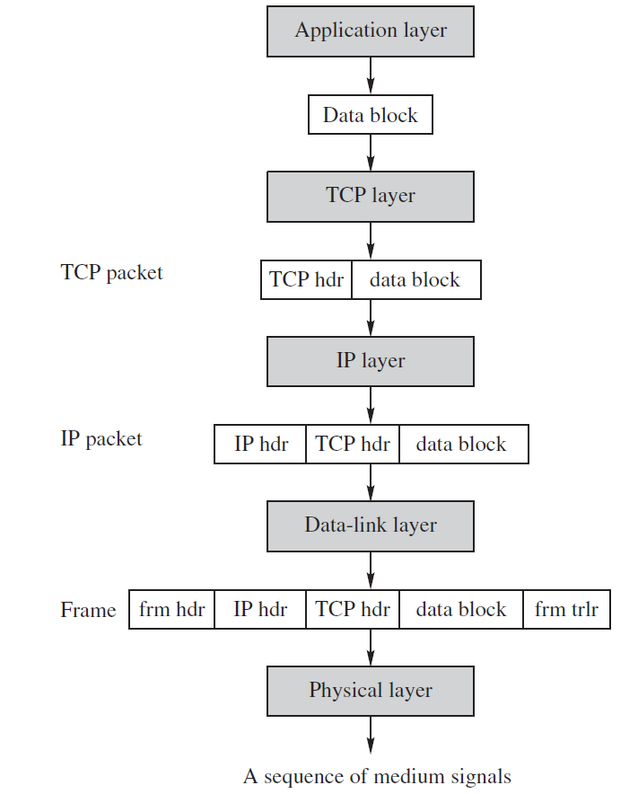
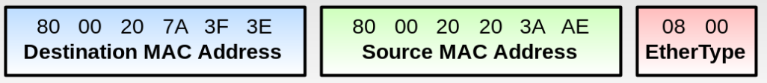
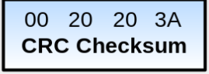
Deployment network secure protocols
PGP and S/MIME Email Security Protocols
SSL/TLS, SSH protocol
Ipsec, VPN protocols
WEB, WPA, WPA2, WPA 2 …
Notes:
frm trlr =redundancy check (CRC) trailer;

Slide 37
What Are the Pros and Cons?
Application Layer
Provides end-to-end security protection
Intermediate nodes need not to decrypt data or check for signatures
Attackers may analyse traffic and modify headers
Transport Layer
Provides security protections for TCP packets
No need to modify any application programs
Attackers may analyse traffic via IP headers

Slide 38
What Are the Pros and Cons?
Network Layer
Provides node-to-node security protection
Transport mode: Encrypt payload only
Tunnel mode: Encrypt both header & payload; need a gateway
No need to modify any application programs
Data-link Layer
Provides security protections for frames
No need to modify any application programs
Traffic analysis would not yield much info

Slide 39
SSH protocol
SSH Connection:
Sets up multiple channels for different applications in a single SSH connection
SSH User Authentication:
Authenticate user to server
Using password or PKC
SSH Transport
Handles initial setup: server authentication, and key exchange
Set up encryption and compression algorithms
SSH Connection
SSH User Authentication
Application Layer
SSH Transport
TCP
IP
Data Link
Physical
SSH architecture

Slide 40
SSH protocol
Notes:
40

Slide 41
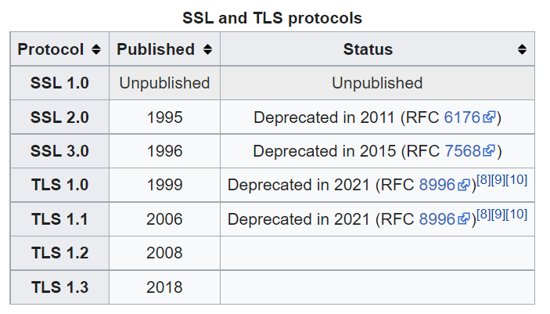
SSL/TLS
Secure Socket Layer Protocol (SSL)
Designed by Netscape in 1994
https://en.wikipedia.org/wiki/Transport_Layer_Security

Slide 42
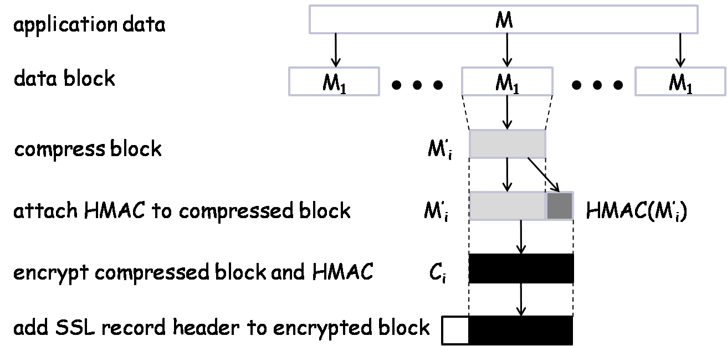
TLS Record Protocol Diagram
SSL record protocol

Slide 43
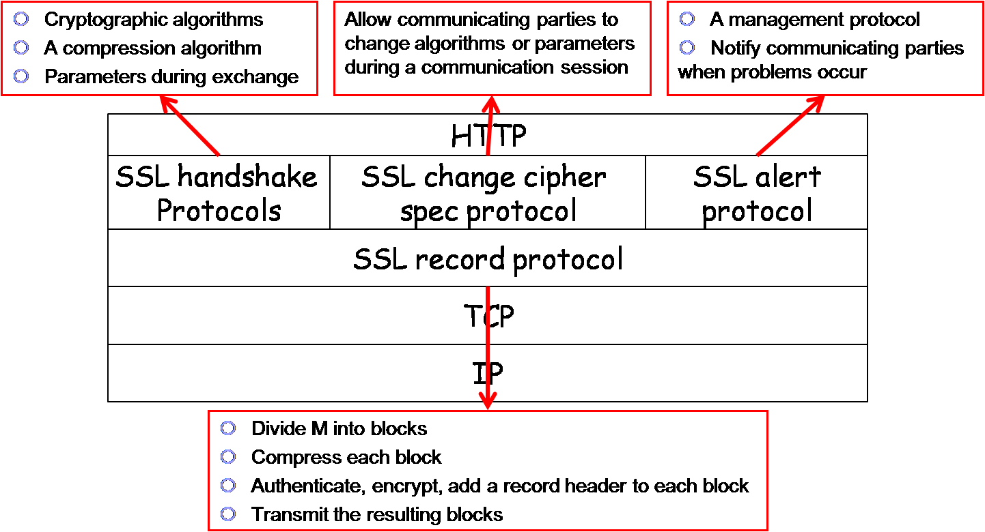
TSL Structure

Slide 44
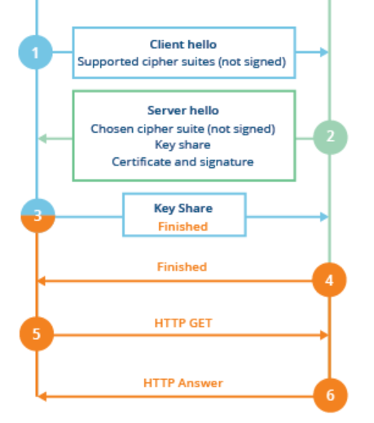
TSL protocol v 1.2
Client
Server
(EC)DHE

Slide 45

TSL protocol v 1.3
Client
Server
https://datatracker.ietf.org/doc/html/rfc8446

Slide 46

TSL protocol v 1.2
Authentication: digital certificate;
Key agreement(ex. ECDH)
Cryptographic algorithm negotiation (ciphers, MAC)

Slide 47
TSL protocol v 1.3
Client
Server
https://datatracker.ietf.org/doc/html/rfc8446

Slide 48
IPsec: Network-Layer Protocol
IPsec encrypts and/or authenticates IP packets
It consists of three protocols:
Authentication header (AH)
To authenticate the origin of the IP packet and ensure its integrity
To detect message replays using sliding window
Encapsulating security payload (ESP)
Encrypt and/or authenticate IP packets
Internet key exchange (IKE)
Establish secret keys for the sender and the receiver
Runs in one of two modes:
Transport Mode
Tunnel Mode (requires gateway)‏

Slide 49

IPsec Packet Layout
H_{t}
M_{i}
segment

Slide 50
IPsec Transport Mode
Host-to-host (end-to-end) security:
IPsec processing performed at endpoints of secure channel.
Endpoint hosts must be IPsec-aware.
Header
Payload
Header
Payload
IP datagram
network
IP datagram

Slide 51
IPsec Tunnel Mode
Header
Payload
Header
Payload
Inner IP datagram
Inner IP datagram
Security
Gateway
network
Security
Gateway
Outer
Header
Header
Payload
Outer
Header
Header
Payload

Slide 52
Remote Host to Internal Server
Remote host has Internet access to gateway, then gains access to server behind gateway.
Traffic to server protected in inner tunnel.
Outer tunnel protects inner traffic over Internet.
Outer Tunnel
Inner tunnel
Internet
Local network
remote
host
Security
Gateway
server

Slide 53
IPsec Security Associations
Alice
Bob
SA
If Alice wants to establish an IPsec connection with Bob, the two parties must first negotiate a set of keys and algorithms
The concept of security association (SA) is a mechanism for this purpose
An SA is formed between an initiator and a responder, and lasts for one session
An SA is for encryption or authentication, but not both.
If a connection needs both, it must create two SAs, one for encryption and one for authentication

Slide 54
SA Components
Three parameters:
Security parameters index (SPI)
IP destination address
Security protocol identifier
Security Association Database (SAD)
Stores active SAs used by the local machine
Security Policy Database (SPD)
A set of rules to select packets for encryption / authentication
SA Selectors (SAS)
A set of rules specifying which SA(s) to use for which packets

Slide 55
IPsec Header
IPsec Header
Authentication Header (AH)‏
Encapsulated Security Payload (ESP)‏
Authentication and Encryption use separate SAs
Data confidentiality
Data origin authentication,
data integrity checking, and
replay protection (optional)

Slide 56

Authentication Header

Slide 57
Resist Message Replay Attack
Sequence number is used with a sliding window to thwart message replay attacks
A
B
C
Given an incoming packet with sequence # s, either
s in A – It's too old, and can be discarded
s in B – It's in the window. Check if it's been seen before
s in C – Shift the window and act like case B

Slide 58

Encapsulated Security Payload

Slide 59
ESP Protocol – Transport & Tunnel
ESP in transport mode:
Original
IP header
ESP hdr
SPI, seqno
Payload
(eg TCP, UDP, ICMP)
ESP
trlr
ESP
auth
MAC scope
ESP in tunnel mode:
Encryption scope
Outer
IP header
ESP hdr
SPI, seqno
Inner
IP header
Payload
(eg TCP, UDP, ICMP)
ESP
trlr
ESP
auth
MAC scope
Encryption scope

Slide 60
Key Determination and Distribution
Oakley key determination protocol (KDP)
Diffie-Hellman Key Exchange + authentication & cookies
Authentication helps resist man-in-the-middle attacks
Cookies help resist clogging attacks
Nonce helps resist message replay attacks

Slide 61
Clogging Attacks
A form of denial of service attacks
Attacker sends a large number of public key Y_{i} in crafted IP packets, forcing the victim’s computer to compute secret keys K_{i} = Y_{i}^{X} mod p over and over again
Diffie-Hellman is computationally intensive because of modular exponentiations
Cookies help
Before doing computation, recipient sends a cookie (a random number) back to source and waits for a confirmation including that cookie
This prevents attackers from making DH requests using crafted packets with crafted source addresses

Slide 62

ISAKMP
ISAKMP: Internet Security Association and Key Management Protocol
Specifies key exchange formats
Each type of payload has the same form of a payload header
ISAKMP header

Slide 63
ISAKMP Payload Types
SA: for establishing a security association
Proposal: for negotiating an SA
Transform: for specifying encryption and authentication algorithms
Key-exchange: for specifying a key-exchange algorithm
Identification: for carrying info and identifying peers
Certificate-request: for requesting a public-key certificate
Certificate: contain a public-key certificate
Hash: contain the hash value of a hash function
Signature: contain the output of a digital signature function
Nonce: contain a nonce
Notification: notify the status of the other types of payloads
Delete: notify the receiver that the sender has deleted an SA or SAs
8-bit
Next payload
8-bit
Reserved
16-bit
Payload length

